Slide 1
CHƯƠNG TRÌNH ĐÀO TẠO NHÂN VIÊN
MÔN HỌC: CSS
SASS
Trình bày:
Sơn VQ
Duy LD
Thái NQ
Cương NTK
Thắng NN
HANOI – JUN, 2015
6/15/15
www.qsoftvietnam.com
1
Notes:
1

Slide 2
Object-oriented CSS
Why we need Sass
Introduction to Sass
Part I
Variable, Nest, Mixin
Extend, Import

Slide 3
Math, Loop, Condition, Function
Introduction to Compass
Disadvantages of Sass
Part II
Sass Vs Less
Tool, Cheat sheet, Best practices

Slide 4
Object-oriented CSS
Why we need Sass
Introduction to Sass
Part I
Variable, Nest, Mixin
Extend, Import

Slide 5
What is object-oriented CSS?
A methodology of writing reusable CSS that is fast, scalable and maintainable.

Slide 6
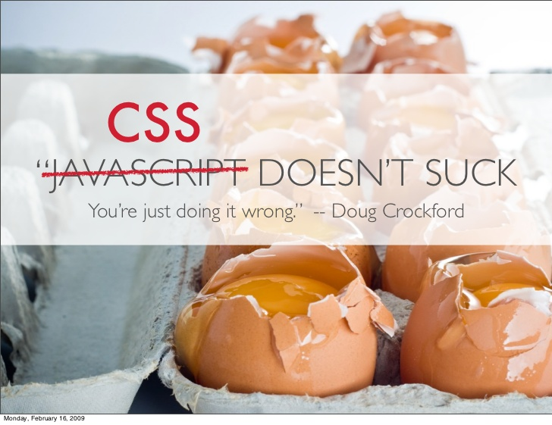

Slide 7
CODE RE-USE IS ALMOST NONEXISTENT
people don’t trust other developers code

Slide 8

Anything re-usable?

Slide 9
OVERRIDING IS VERY COMPLEX
Almost my css lines of code is overridden

Slide 10
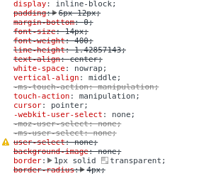

Slide 11
FILE SIZE JUST KEEPS GETTING BIGGER
As the site evolves we continuously modify the CSS

Slide 12


SOLUTION
Object Oriented CSS

Slide 13
TWO MAIN PRINCIPLE
1. Separate Structure and Skin
2. Separate Container and Content

Slide 14
SEPARATE STRUCTURE AND SKIN
Separating positioning (position, float, margin, etc.) from styling (background, color, border, etc.)

Slide 15
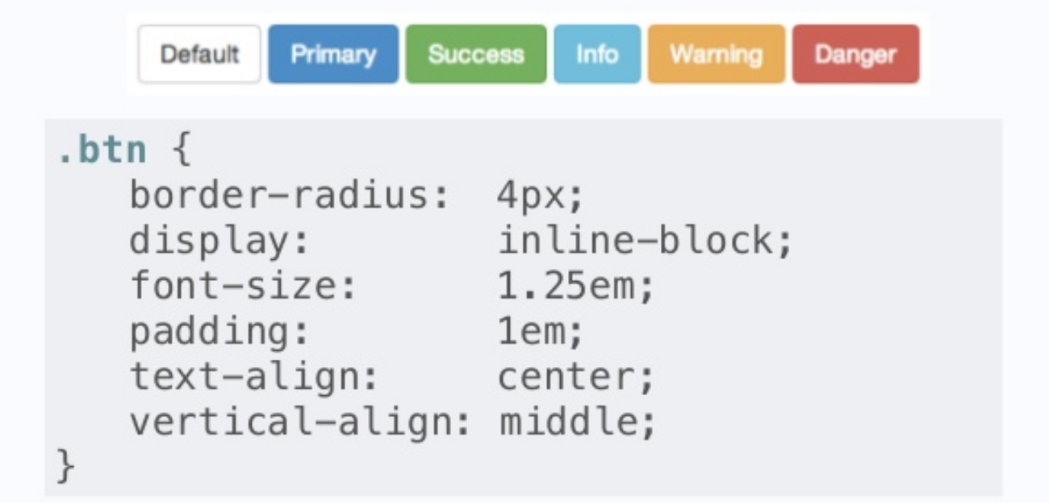

Slide 16
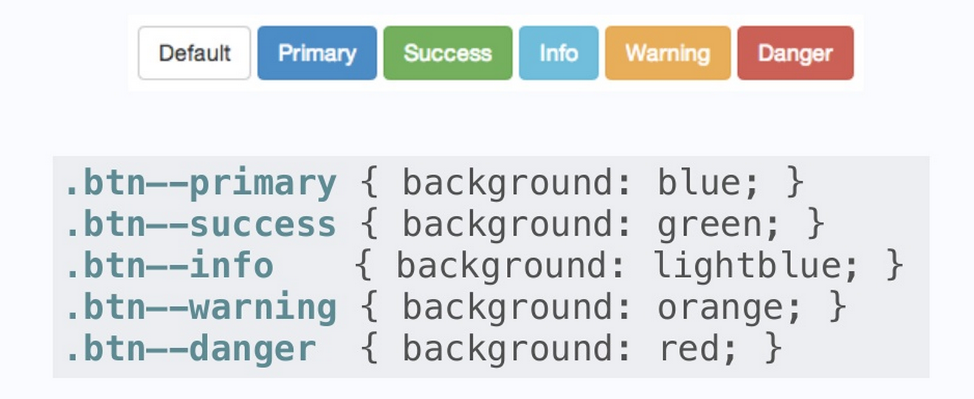

Slide 17
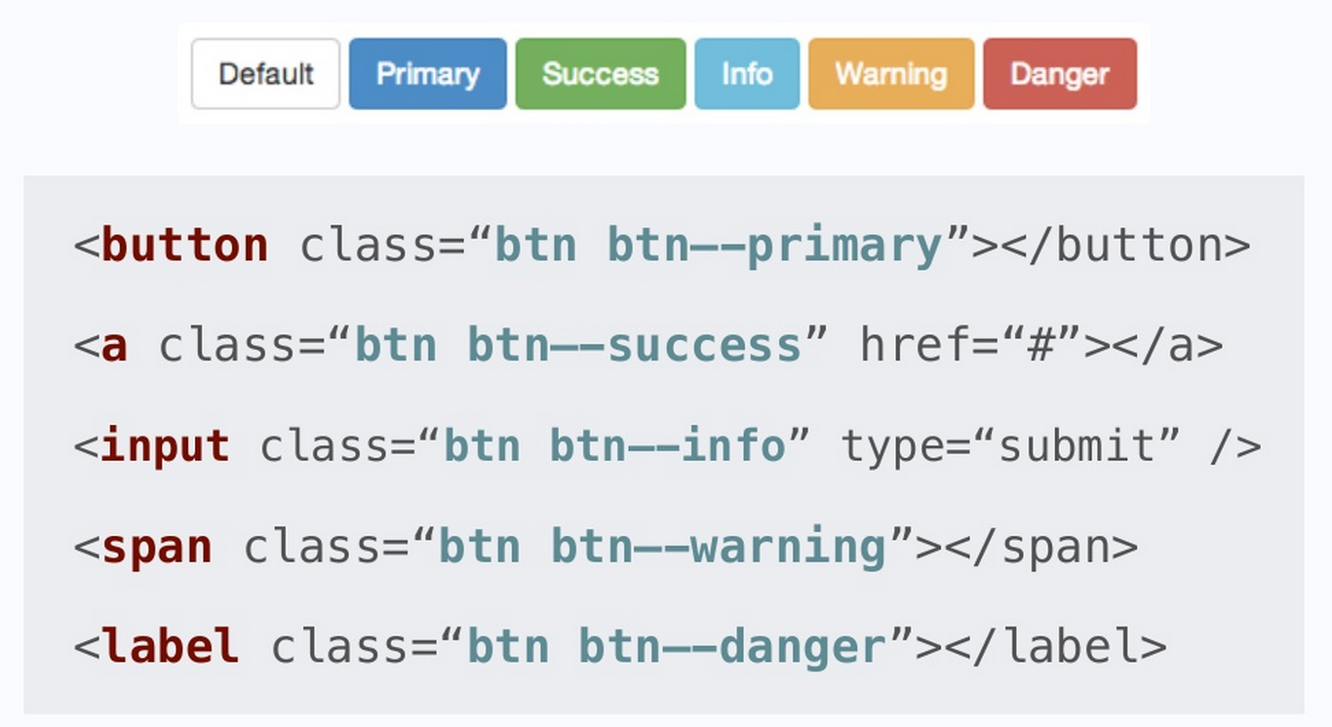

Slide 18
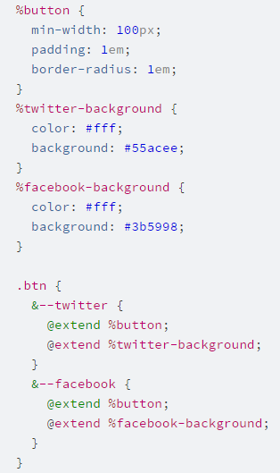
SASS WAY

Slide 19
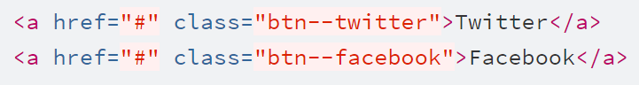
SASS WAY

Slide 20
SEPARATE CONTAINER AND CONTENT
Objects should look the same
no matter where you put them

Slide 21
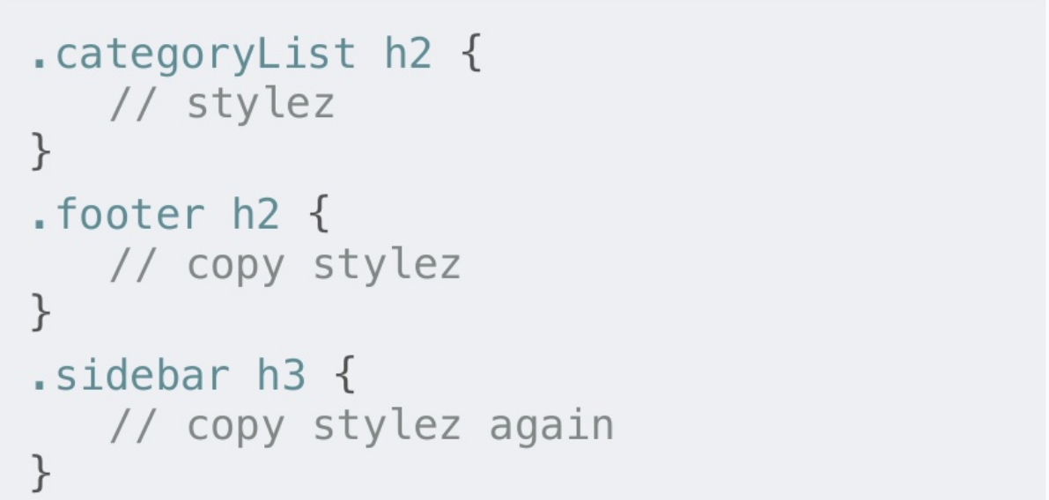
BAD

Slide 22
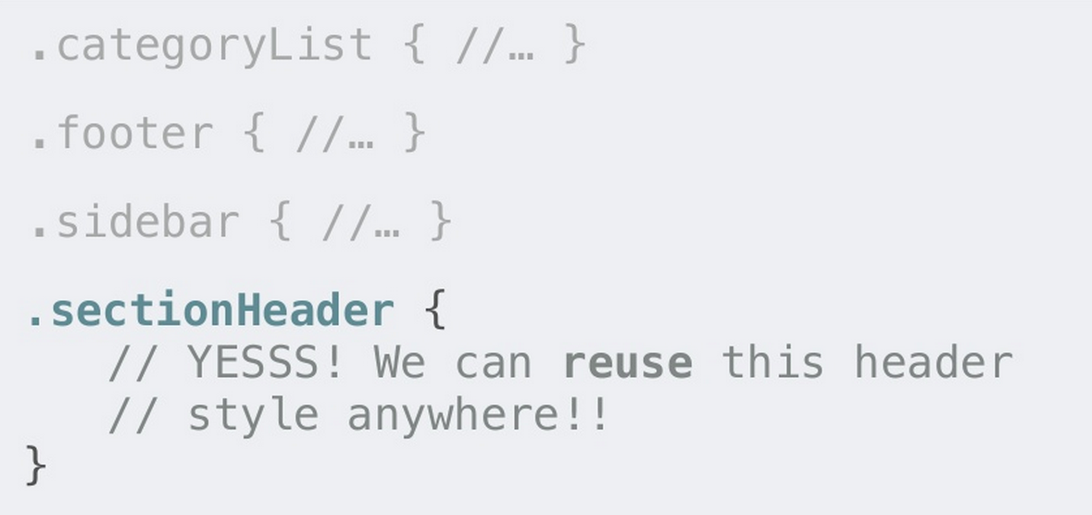
THE RIGHT WAY

Slide 23

h1.page-title h1 .title-underline
.newsletter-block .block .block-gray
.newsletter-subscribe .btn .btn-orange
.recent-post-block .block
aside h3 h3
aside ul .white-list
aside ul li .white-list-item
aside ul li.highlight
.white-list-item .white-list-item-highlight

Slide 24
IMPORTANT NOTES
Avoid styling ID selectors
Avoid attaching class to element selectors, ie. a.sub-title
Avoid styling descendent selectors, ie. .sidebar .recent-post ul li
Avoid !important

Slide 25
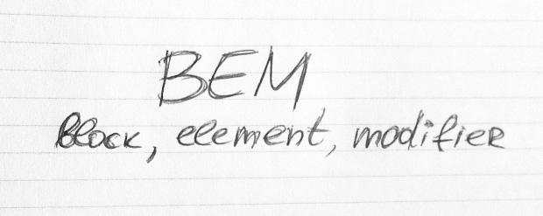
YOU SHOULD READ

Slide 26
Object-oriented CSS
Why we need Sass
Introduction to Sass
Part I
Variable, Nest, Mixin
Extend, Import

Slide 27

6/15/15
www.qsoftvietnam.com
27

Slide 28
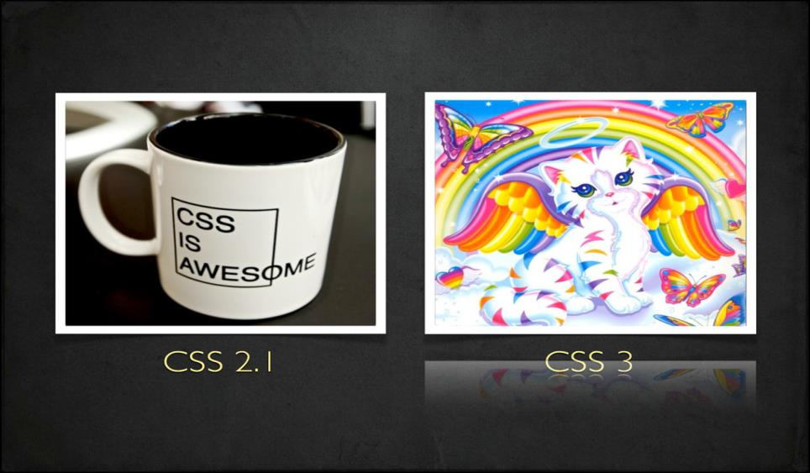
6/15/15
www.qsoftvietnam.com
28

Slide 29
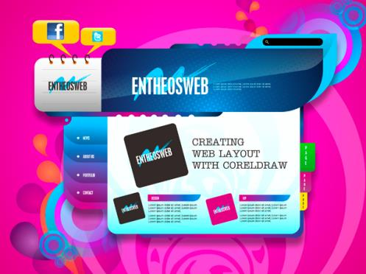
Good Speed
Work on my phone
Wow, 3D animation!
New Fonts
Multiple browser support
Colorful
Unbelievable
What they see
6/15/15
www.qsoftvietnam.com
29

Slide 30
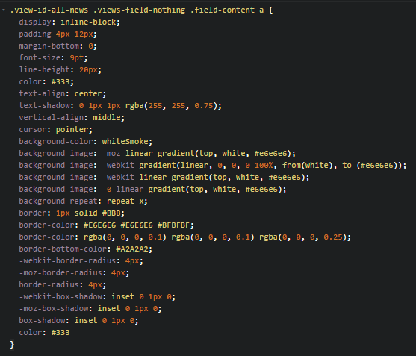

What we see
Too complex, too long
Difficult to maintain
What if customer want to change a color in project?
Ctrl + R => replace all?
6/15/15
www.qsoftvietnam.com
30

Slide 31
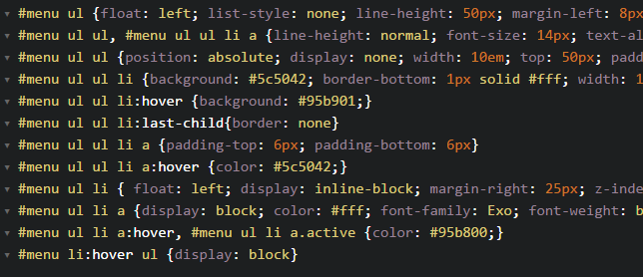
Dupplicate, hard to read
6/15/15
www.qsoftvietnam.com
31

Slide 32
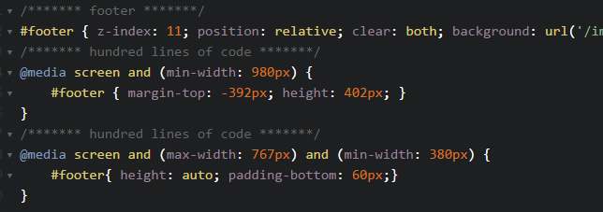
Waste of time
6/15/15
www.qsoftvietnam.com
32

Slide 33
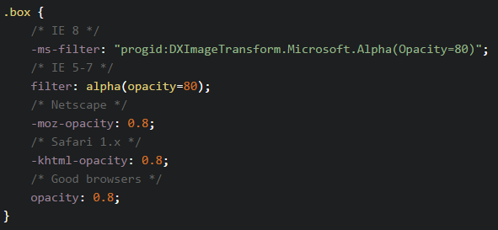
Hard to implement
6/15/15
www.qsoftvietnam.com
33

Slide 34
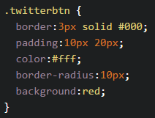
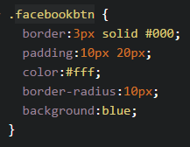


No re-use, just copy & paste
6/15/15
www.qsoftvietnam.com
34

Slide 35
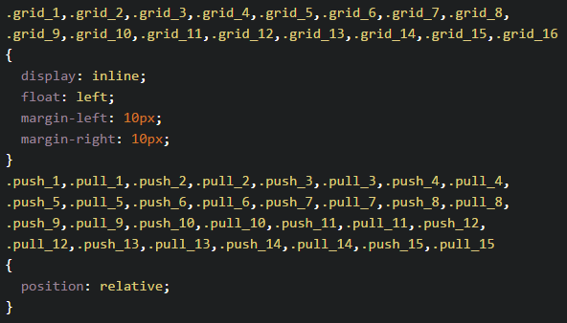
Oh my god, no looping function
6/15/15
www.qsoftvietnam.com
35

Slide 36
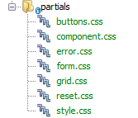
Separate CSS are good enough?
=> HTTP requests problem
6/15/15
www.qsoftvietnam.com
36

Slide 37
What we need?
Easy to change/maintain (Variable)
Easy to read (Nesting)
Easy to write (Mixins)
No duplicate, reusable code (Extend/Inheritance)
Easy to organize, fewer requests (Partials, Import)
Powerful (Operators, Condition, Loop)
6/15/15
www.qsoftvietnam.com
37

Slide 38
Object-oriented CSS
Why we need Sass
Introduction to Sass
Part I
Variable, Nest, Mixin
Extend, Import

Slide 39

Introduction to
6/15/15
www.qsoftvietnam.com
39

Slide 40
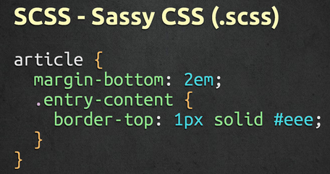
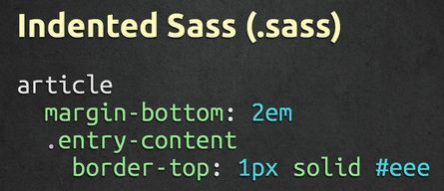
What is Sass
Syntactically Awesome StyleSheets
Simple but powerful syntax for creating manageable CSS
Too “flavors” – SASS & SCSS
6/15/15
www.qsoftvietnam.com
40

Slide 41
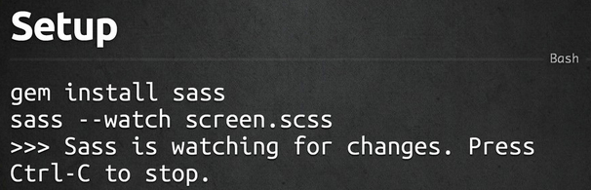
How to install
6/15/15
www.qsoftvietnam.com
41

Slide 42
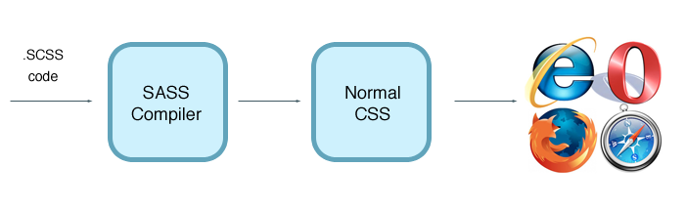
Sass work flow
6/15/15
www.qsoftvietnam.com
42

Slide 43
Object-oriented CSS
Why we need Sass
Introduction to Sass
Part I
Variable, Nest, Mixin
Extend, Import

Slide 44

6/15/15
www.qsoftvietnam.com
44

Slide 45
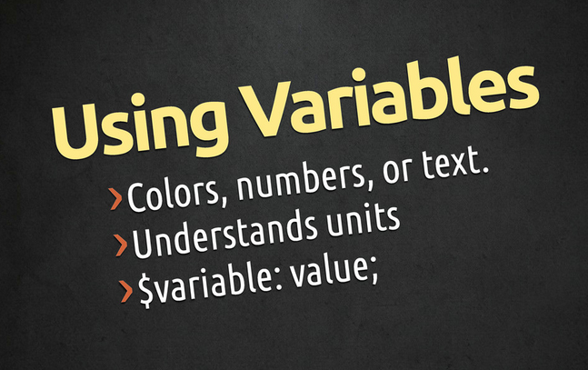
6/15/15
www.qsoftvietnam.com
45

Slide 46
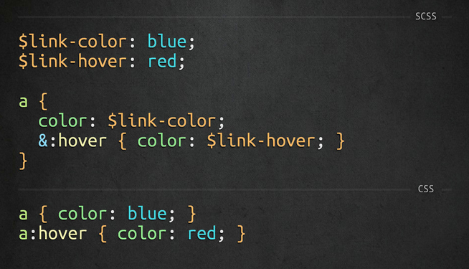
6/15/15
www.qsoftvietnam.com
46

Slide 47
Object-oriented CSS
Why we need Sass
Introduction to Sass
Part I
Variable, Nest, Mixin
Extend, Import

Slide 48

6/15/15
www.qsoftvietnam.com
48

Slide 49
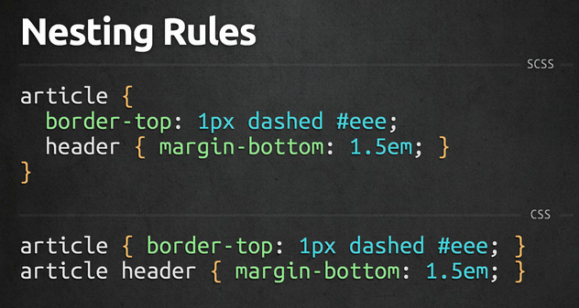
6/15/15
www.qsoftvietnam.com
49

Slide 50
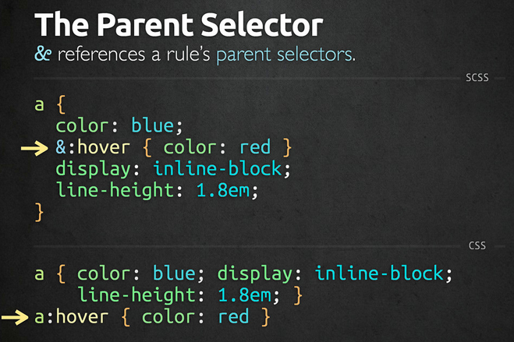
6/15/15
www.qsoftvietnam.com
50

Slide 51
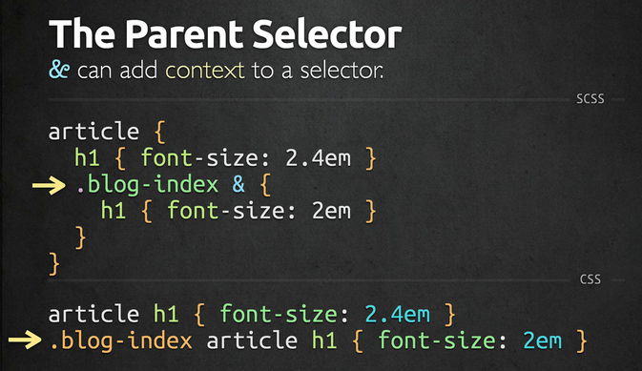
6/15/15
www.qsoftvietnam.com
51

Slide 52
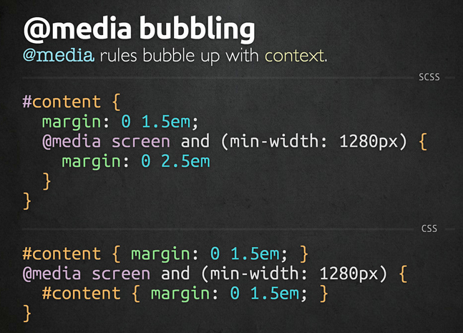
6/15/15
www.qsoftvietnam.com
52

Slide 53
Object-oriented CSS
Why we need Sass
Introduction to Sass
Part I
Variable, Nest, Mixin
Extend, Import

Slide 54

6/15/15
www.qsoftvietnam.com
54

Slide 55
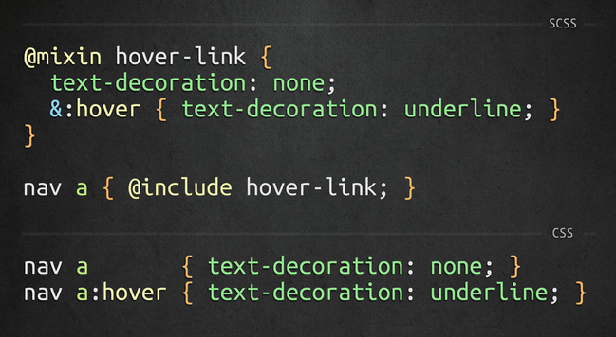
6/15/15
www.qsoftvietnam.com
55

Slide 56
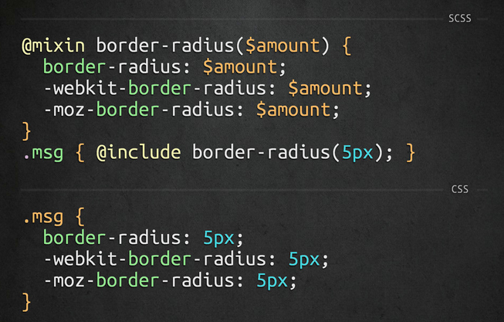
6/15/15
www.qsoftvietnam.com
56

Slide 57
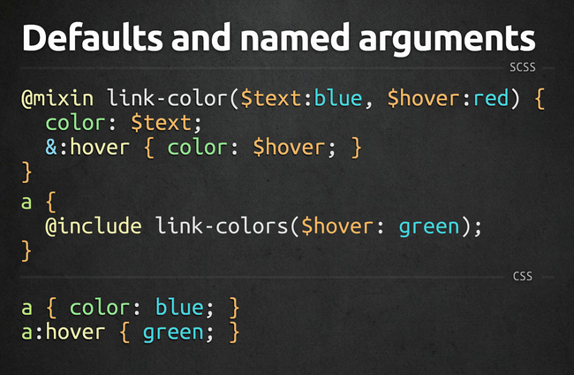
6/15/15
www.qsoftvietnam.com
57

Slide 58
Object-oriented CSS
Why we need Sass
Introduction to Sass
Part I
Variable, Nest, Mixin
Extend, Import

Slide 59

6/15/15
www.qsoftvietnam.com
59

Slide 60
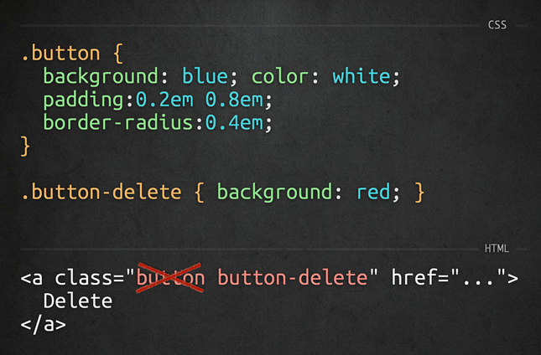
6/15/15
www.qsoftvietnam.com
60

Slide 61
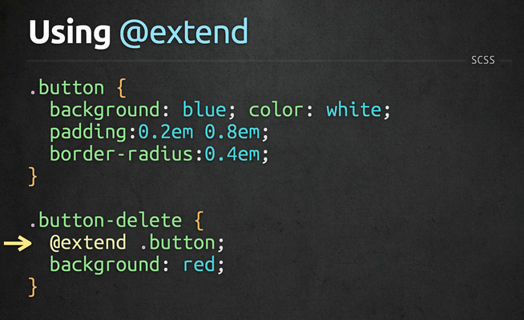
6/15/15
www.qsoftvietnam.com
61

Slide 62
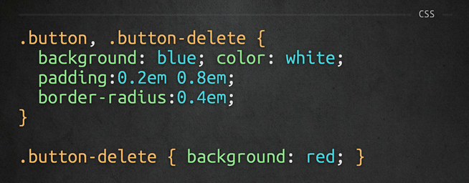
6/15/15
www.qsoftvietnam.com
62

Slide 63
Object-oriented CSS
Why we need Sass
Introduction to Sass
Part I
Variable, Nest, Mixin
Extend, Import

Slide 64

6/15/15
www.qsoftvietnam.com
64

Slide 65
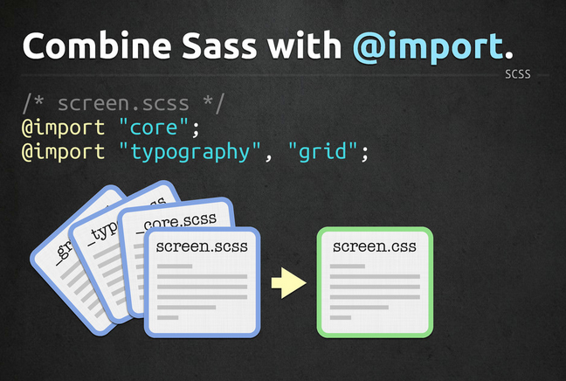
6/15/15
www.qsoftvietnam.com
65

Slide 66
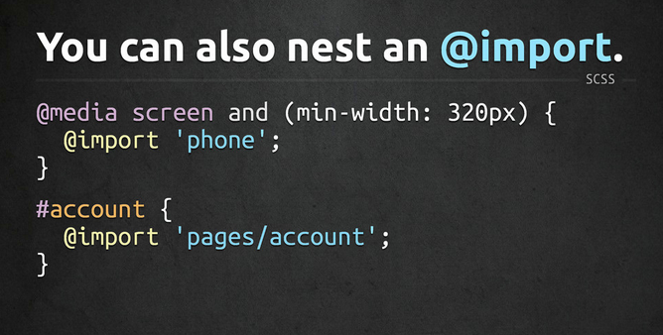
6/15/15
www.qsoftvietnam.com
66

Slide 67
Object-oriented CSS
Why we need Sass
Introduction to Sass
Part I
Variable, Nest, Mixin
Extend, Import

Slide 68
Math, Loop, Condition, Function
Introduction to Compass
Disadvantages of Sass
Part II
Sass Vs Less
Tool, Cheat sheet, Best practices

Slide 69

6/15/15
www.qsoftvietnam.com
69

Slide 70
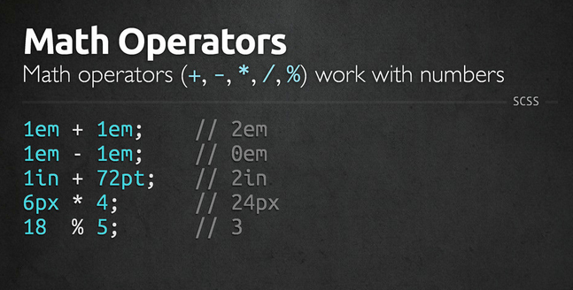
6/15/15
www.qsoftvietnam.com
70

Slide 71
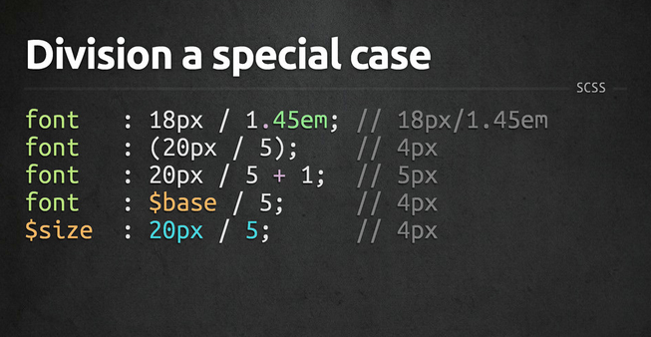
6/15/15
www.qsoftvietnam.com
71

Slide 72
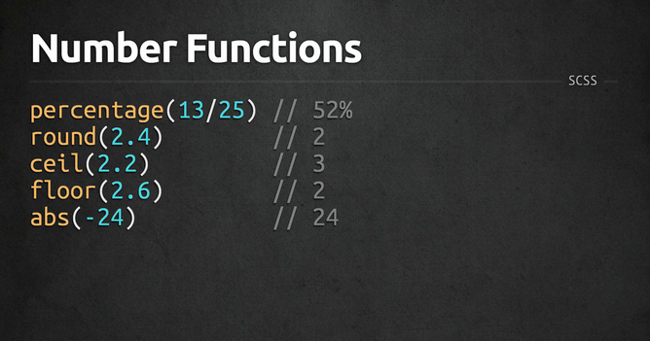
6/15/15
www.qsoftvietnam.com
72

Slide 73
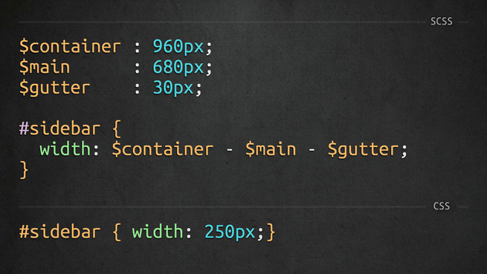
6/15/15
www.qsoftvietnam.com
73

Slide 74
Math, Loop, Condition, Function
Introduction to Compass
Disadvantages of Sass
Part II
Sass Vs Less
Tool, Cheat sheet, Best practices

Slide 75

6/15/15
www.qsoftvietnam.com
75

Slide 76

6/15/15
www.qsoftvietnam.com
76

Slide 77
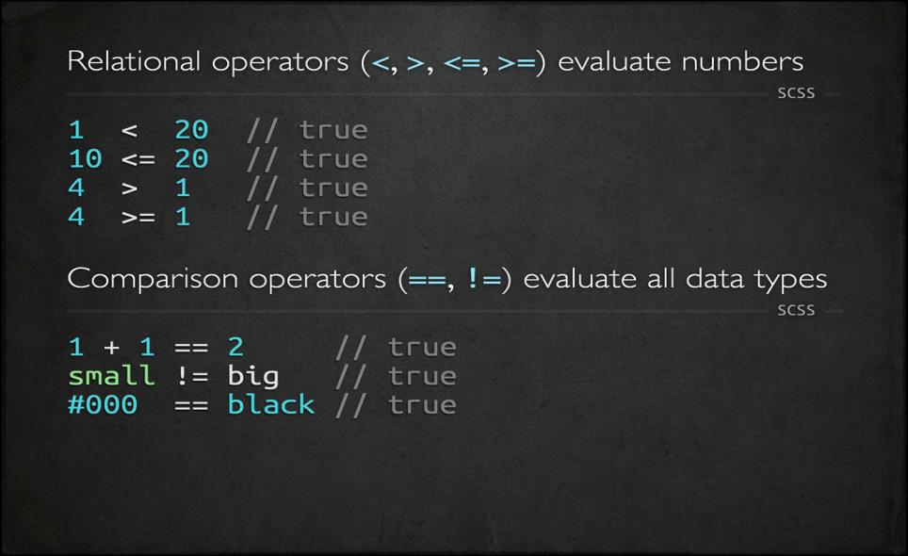
6/15/15
www.qsoftvietnam.com
77

Slide 78
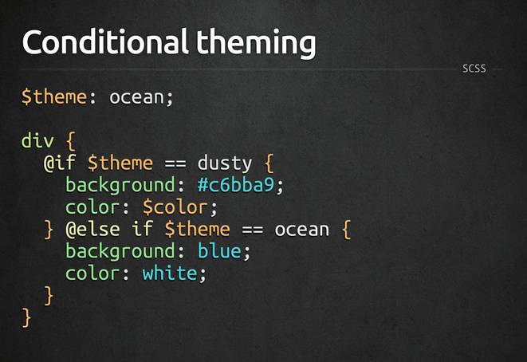
6/15/15
www.qsoftvietnam.com
78

Slide 79
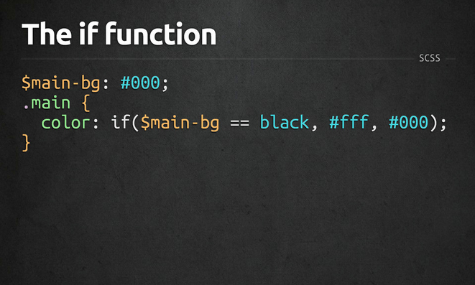
6/15/15
www.qsoftvietnam.com
79

Slide 80
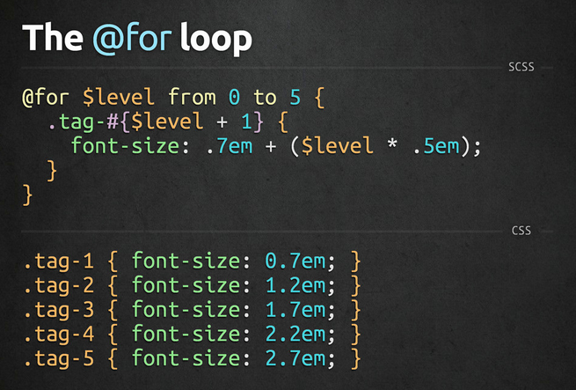
6/15/15
www.qsoftvietnam.com
80

Slide 81
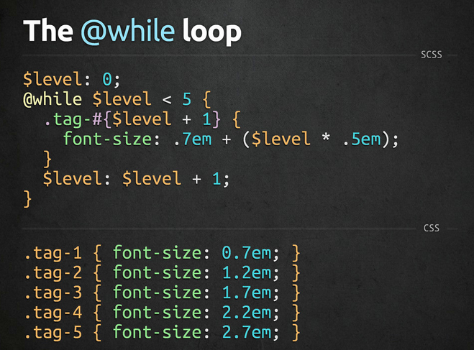
6/15/15
www.qsoftvietnam.com
81

Slide 82
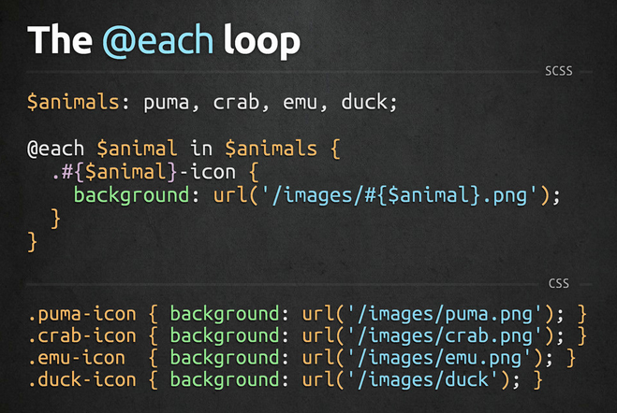
6/15/15
www.qsoftvietnam.com
82

Slide 83

6/15/15
www.qsoftvietnam.com
83

Slide 84
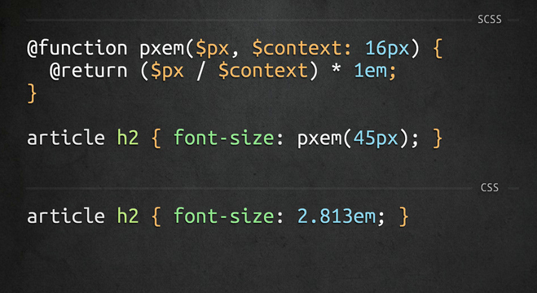
6/15/15
www.qsoftvietnam.com
84

Slide 85
Math, Loop, Condition, Function
Introduction to Compass
Disadvantages of Sass
Part II
Sass Vs Less
Tool, Cheat sheet, Best practices

Slide 86

Introduction to
6/15/15
www.qsoftvietnam.com
86
Notes:
http://compass-style.org/reference/compass/css3/
86

Slide 87
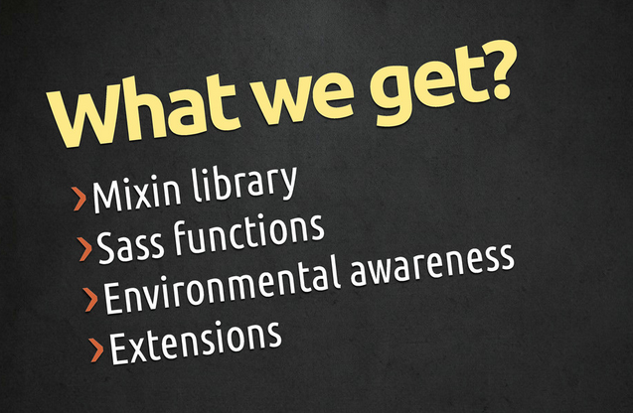
6/15/15
www.qsoftvietnam.com
87

Slide 88

How to install
6/15/15
www.qsoftvietnam.com
88

Slide 89

6/15/15
www.qsoftvietnam.com
89

Slide 90

6/15/15
www.qsoftvietnam.com
90

Slide 91

6/15/15
www.qsoftvietnam.com
91

Slide 92

6/15/15
www.qsoftvietnam.com
92

Slide 93
Math, Loop, Condition, Function
Introduction to Compass
Disadvantages of Sass
Part II
Sass Vs Less
Tool, Cheat sheet, Best practices

Slide 94
Disadvantages
Not for beginners:
Need basic CSS, time to understand SASS
Need basic programming knowledge (problem for designer)
Need installation/environment setup
Need time to compile
A little bit hard to debug
Can’t edit on live server (nah, you shouldn’t do that)
6/15/15
www.qsoftvietnam.com
94

Slide 95
Math, Loop, Condition, Function
Introduction to Compass
Disadvantages of Sass
Part II
Sass Vs Less
Tool, Cheat sheet, Best practices

Slide 96

LESS Condition
6/15/15
www.qsoftvietnam.com
96
Notes:
http://www.zingdesign.com/less-vs-sass-its-time-to-switch-to-sass/
https://css-tricks.com/sass-vs-less/
https://gist.github.com/chriseppstein/674726

Slide 97

LESS Loop
6/15/15
www.qsoftvietnam.com
97
Notes:
http://www.zingdesign.com/less-vs-sass-its-time-to-switch-to-sass/
https://css-tricks.com/sass-vs-less/
https://gist.github.com/chriseppstein/674726

Slide 98

LESS Loop
6/15/15
www.qsoftvietnam.com
98
Notes:
http://www.zingdesign.com/less-vs-sass-its-time-to-switch-to-sass/
https://css-tricks.com/sass-vs-less/
https://gist.github.com/chriseppstein/674726

Slide 99
Sass VS Less
 | SASS | LESS | Winner
Environment | Ruby | Javascript | Nobody
Helping with CSS3 | Compass, Bourbon | LESS Elements | SASS
Language Ability | If, else, elseif, for, while, each | when | SASS
Generate code (@extend) | Copy paste like mixin of Sass | Group same code Silent extend | SASS
Variable | $variable | @variable (@keyframes, @media) | Nobody
6/15/15
www.qsoftvietnam.com
99
Notes:
http://www.zingdesign.com/less-vs-sass-its-time-to-switch-to-sass/
https://css-tricks.com/sass-vs-less/
https://gist.github.com/chriseppstein/674726

Slide 100
Math, Loop, Condition, Function
Introduction to Compass
Disadvantages of Sass
Part II
Sass Vs Less
Tool, Cheat sheet, Best practices

Slide 101
Sass Tools
Prepros
Livereload
Hammer
Koala
Scout
Bourbon
6/15/15
www.qsoftvietnam.com
101

Slide 102
Sass Tools
Compile SASS to CSS
Add mixins, functions, helpers
Add compass, autoPrefix, SourceMaps
Output style: Compressed, Compact, Nested, Expended
6/15/15
www.qsoftvietnam.com
102

Slide 103

6/15/15
www.qsoftvietnam.com
103

Slide 104

Sass Cheatsheet
http://jurs.me/scss-cheat-sheet/
http://sass-cheatsheet.brunoscopelliti.com/
http://www.cheatography.com/tag/sass/
Notes:
http://codepen.io/quangsonpro/public-titles-asc/

Slide 105
Sass Best Practices
Nest only when necessary
No more than 4 levels deep
Before writing a custom mixin, look for it in compass
http://compass-style.org/reference/compass/css3/
Variable naming convention ${modifer(s)}-{name}
$link-color, $dark-link-color, $large-border-radius
Don’t reduce mixin usage, use params input
Extend is better than mixin
Notes:
http://codepen.io/quangsonpro/public-titles-asc/

Slide 106


Sass Best Practices
Notes:
http://codepen.io/quangsonpro/public-titles-asc/

Slide 107

Notes:
http://codepen.io/quangsonpro/public-titles-asc/

Slide 108

Notes:
http://codepen.io/quangsonpro/public-titles-asc/

Slide 109

Notes:
http://codepen.io/quangsonpro/public-titles-asc/

Slide 110
Notes:
http://codepen.io/quangsonpro/public-titles-asc/

Slide 111
Sass Best Practices
Keep Things Simple
Notes:
The simple as possible. The purpose of Sass is to write cleaner more manageable CSS. Before creating any new mixins, variables, or functions, ensure that their presence will enhancconcluding point I’ll make in this post is to keep things as e development and not overcomplicate things. All Sass features are useful when used in the correct situations and in moderation.
Creating an endless list of variables without clear usage, or a complex function that is difficult to understand for anyone other than the author is not the intention and will not aid development or produce DRY CSS.

Slide 112

Combination
Html
Haml
Markdown
Slim
Jade
CSS
Less
SCSS
SASS
Stylus
Javascript
CoffeeScript
LiveScript
TypeScript
Babel
Notes:
The simple as possible. The purpose of Sass is to write cleaner more manageable CSS. Before creating any new mixins, variables, or functions, ensure that their presence will enhancconcluding point I’ll make in this post is to keep things as e development and not overcomplicate things. All Sass features are useful when used in the correct situations and in moderation.
Creating an endless list of variables without clear usage, or a complex function that is difficult to understand for anyone other than the author is not the intention and will not aid development or produce DRY CSS.
http://codepen.io/drshoggoth/pen/upnFx

Slide 113
THANK YOU FOR YOUR ATTENTION!
6/15/15
www.qsoftvietnam.com
113

